Slide 1
Ms Excel 365 (intermediate)

Slide 2


Slide 3

Modules
• Work with functions.
• Work with lists.
• Analyze data.
• Visualize data with charts.
• Use PivotTables and PivotCharts

Slide 4
Target Audience
This course is designed for students who already have foundational knowledge and skills in
Excel and who wish to begin taking advantage of some of the higher-level functionality in
Excel to analyze and present data.

Slide 5

1st Day

Slide 6


Working with Functions

Slide 7
Work with Ranges

Slide 8
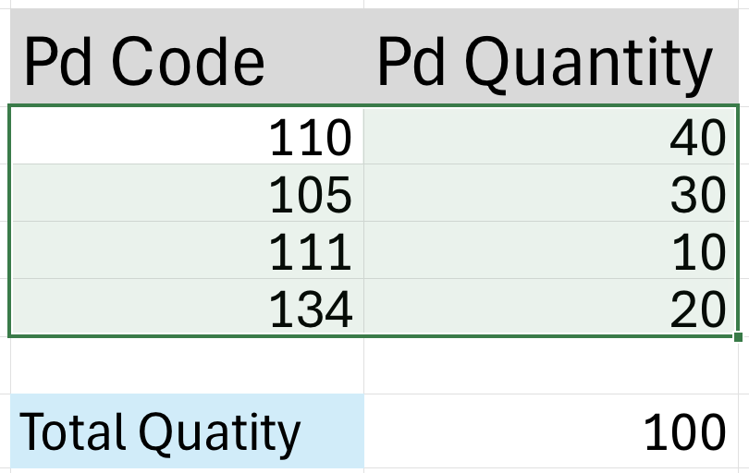
What is a Range?
A range is a group of selected cells in a worksheet.
It can be single cell, a row, a column, or a block of cells.
Ranges are essential for performing calculations, applying formatting, and working with data in Excel.

Slide 9
Selecting Ranges
Contiguous
Non-contiguous

Slide 10
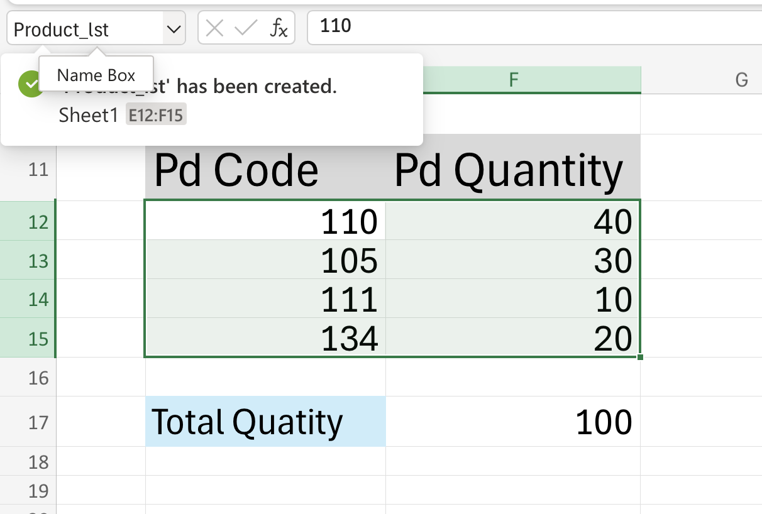
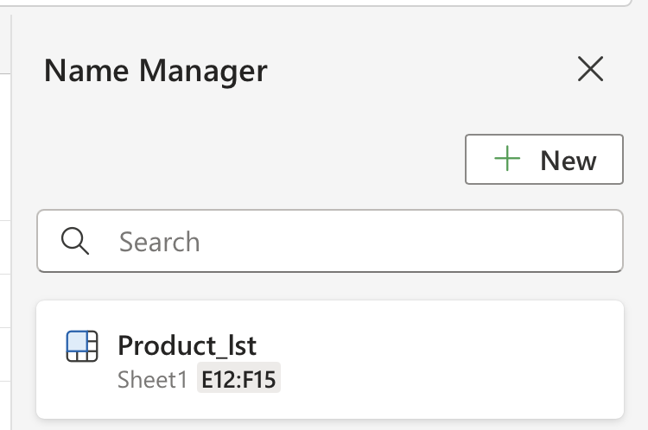
Naming Ranges
Assigning a descriptive name to a range makes formulas easier to understand and manage.
Named range rules
﻿No spaces
﻿Names can only begin with a letter, underscore, or backslash
﻿i.e. you couldn't use 3rdQtr, but could use _3rdQtr or \3rdQtr
﻿Symbols not allowed except as above and the period
﻿Limited to 255 character

Slide 11
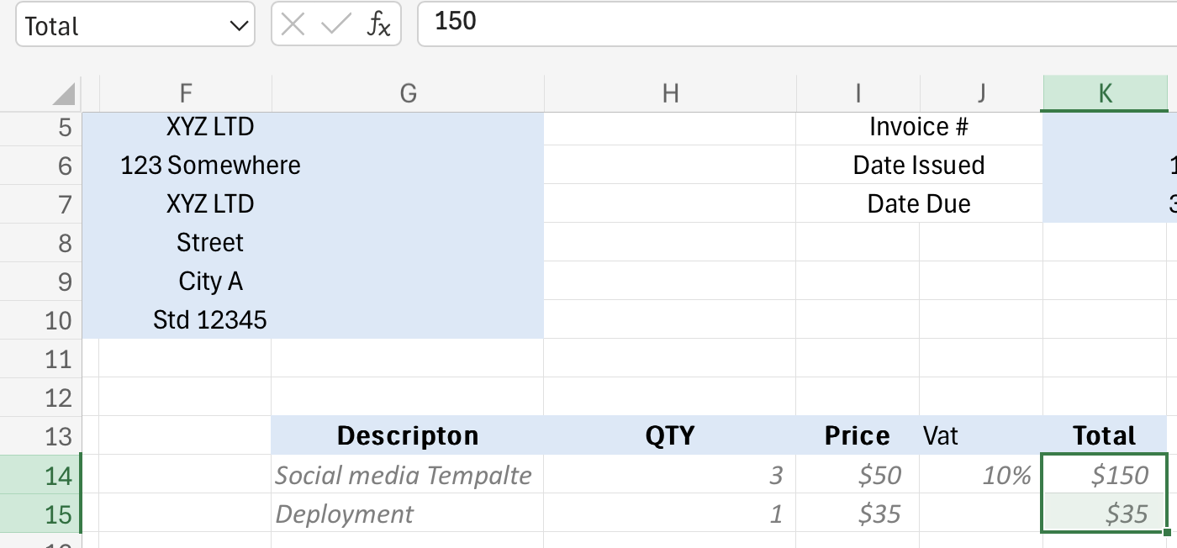
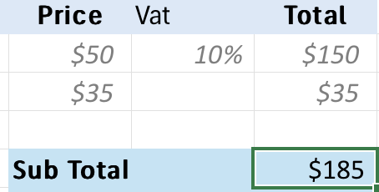
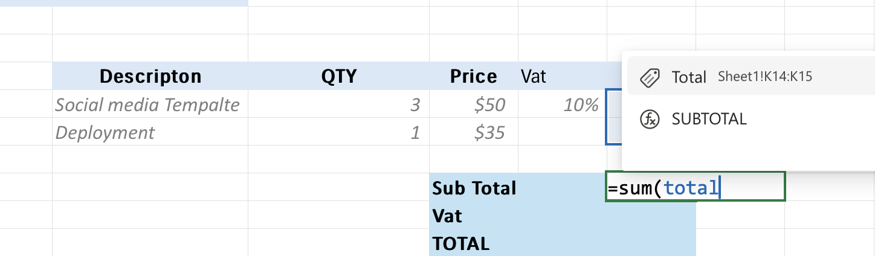
Using Named Ranges in Formulas
Use named ranges in formulas instead of cell references.
=SUM(Total) instead of =SUM(K14:K15)

Slide 12
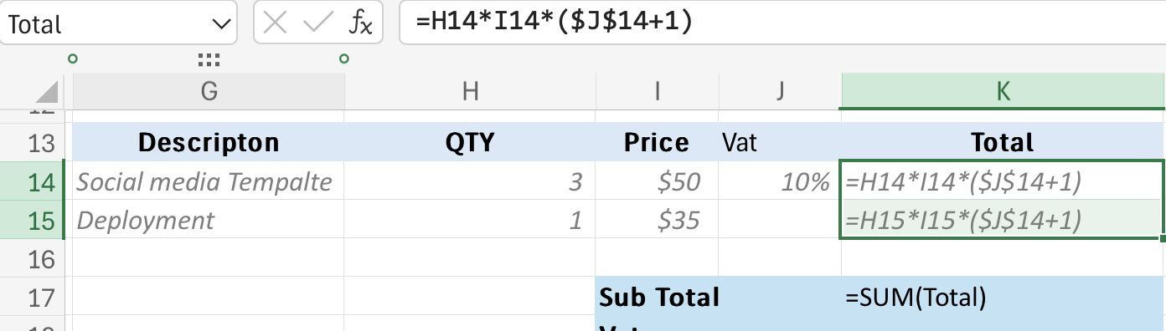
Relative vs. Absolute Referencing
Relative Reference: Cell address changes when the formula is copied. (e.g., A1)
Absolute Reference: Cell address remains fixed when the formula is copied

Slide 13
Dynamic Ranges (Brief Introduction)
Dynamic ranges automatically adjust their size as data is added or removed.
They are created using formulas with functions like OFFSET and COUNT.
Useful for creating charts and reports that update automatically.

Slide 14
Lab
Work with Ranges

Slide 15
Use Specialized Functions

Slide 16
Introduction to Specialized Functions in Excel
Importance of specialized functions for data analysis
Overview of financial, logical, and statistical functions
How specialized functions enhance data manipulation

Slide 17
Financial Functions (NPV, IRR, PMT)
NPV and IRR for investment analysis and cash flow
PMT for calculating loan payments
Crucial for financial modeling and business forecast

Slide 18
Statistical Functions (AVERAGE, MEDIAN, STDEV)
AVERAGE and MEDIAN for central tendency measures
STDEV for analyzing data variability
Supports data analysis and trend identification

Slide 19
Financial functions
(PMT, FV, PV - with practical loan calculations)
Loan Repayments with PMT:
Calculate the periodic payment amount for a loan (e.g., monthly mortgage payment).
Use the PMT function to determine the affordable loan amount or payment schedule.
Gain insights into the long-term cost of borrowing.
Future Value with FV:
Project the future value of an investment with compound interest (e.g., savings account).
Use the FV function to explore different investment scenarios and growth potential.
Make informed decisions about savings and financial goals.
Present Value with PV:
Determine the current value of a future payment or stream of payments (e.g., bond valuation).
Use the PV function to assess the worth of investments and financial obligations.
Make informed decisions about present-day financial commitments.

Slide 20
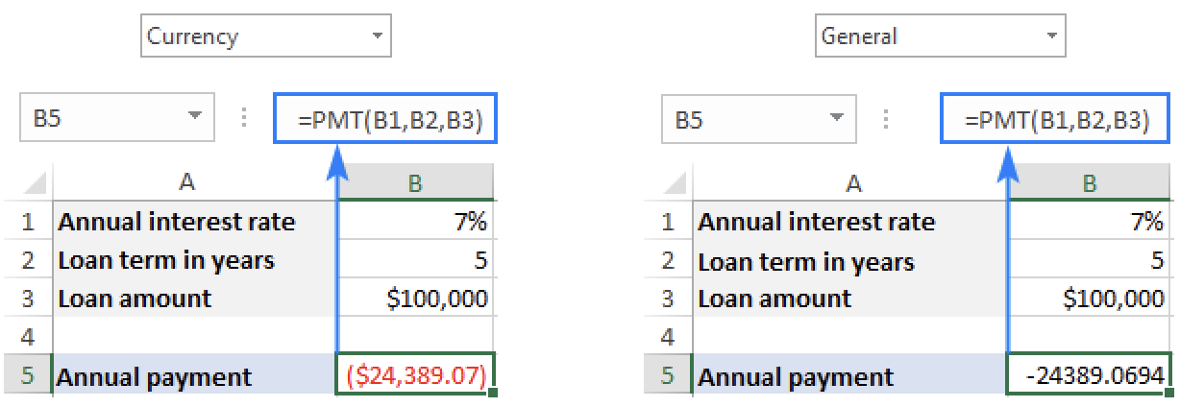
Introduction to function categories
(Financial, Statistical, Lookup)
PMT function in Excel stands for "payment".
PMT(rate, nper, pv, [fv], [type])
Rate (required) - the constant interest rate for the loan
Nper (required) - the total number of payments for the loan or investment.
Pv (required) - the present value
Fv (optional) - the future value
Type (optional) - indicates when the payments are due:
0 or omitted - payments are due at the end of each period.
1 - payments are due at the beginning of each period.

Slide 21
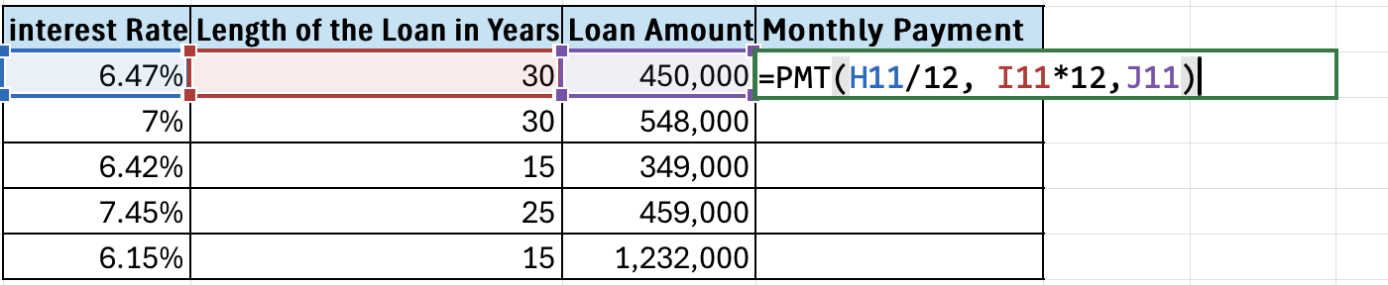
Introduction to function categories
(Financial, Statistical, Lookup)

Slide 22
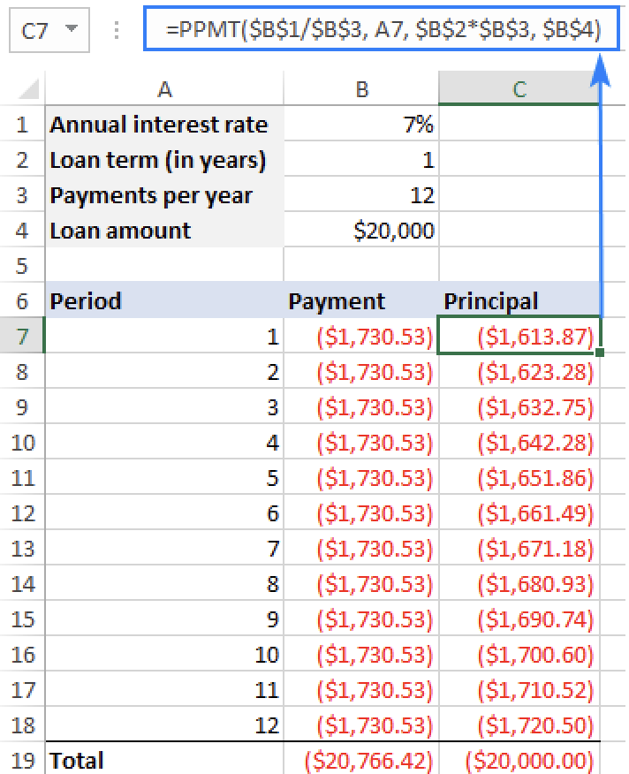
Introduction to function categories
(Financial, Statistical, Lookup)
PPMT function in Excel calculates the principal portion of a loan payment for a given period based on a constant interest rate and payment schedule.
PPMT(rate, per, nper, pv, [fv], [type])
Rate (required) - the constant interest rate for the loan
Per (required) - the target payment period.
Nper (required) - the total number of payments for the loan or investment.
Pv (required) - the present value
Fv (optional) - the future value
Type (optional) - indicates when the payments are due:
0 or omitted - payments are due at the end of each period.
1 - payments are due at the beginning of each period.

Slide 23
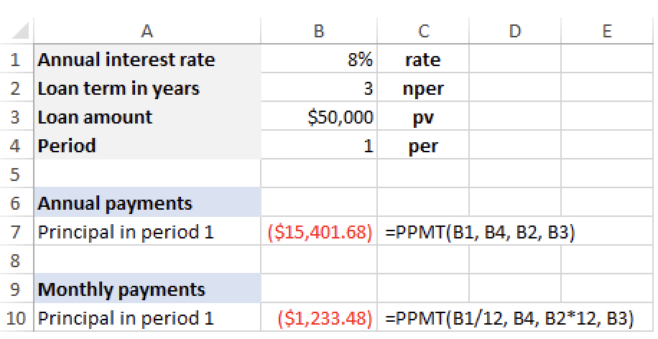
Introduction to function categories
(Financial, Statistical, Lookup)
PPMT(rate, per, nper, pv, [fv], [type])

Slide 24
Statistical functions
(AVERAGEIF, SUMIF, COUNTIF)
Conditional Averages with AVERAGEIF: Calculate the average of a range of cells that meet a specific condition (e.g., average sales for a specific product).
Conditional Sums with SUMIF: Add up values in a range that meet a certain criterion (e.g., total sales for a particular region).
Conditional Counts with COUNTIF: Count the number of cells that satisfy a given condition (e.g., the number of employees in a specific department).

Slide 25
Lookup functions
(VLOOKUP, HLOOKUP)
Vertical Lookups with VLOOKUP: Search for a specific value in a column and return a corresponding value from another column in the same row (e.g., find an employee's salary based on their ID).
Horizontal Lookups with HLOOKUP: Search for a value in a row and return a related value from another row in the same column (e.g., find a product's price based on its name in a table).
Efficient Data Retrieval: Use lookup functions to automate data retrieval and avoid manual searching in large datasets.

Slide 26
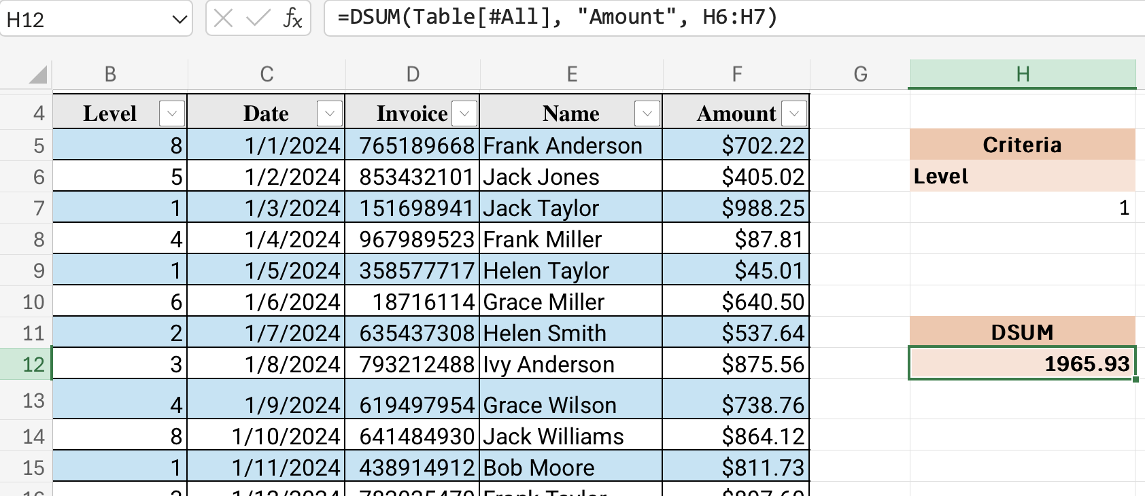
Databse functions
(DSUM)
Single Criteria
Name of the selected Data turned into a Table
All Level 1 invoices Amount

Slide 27
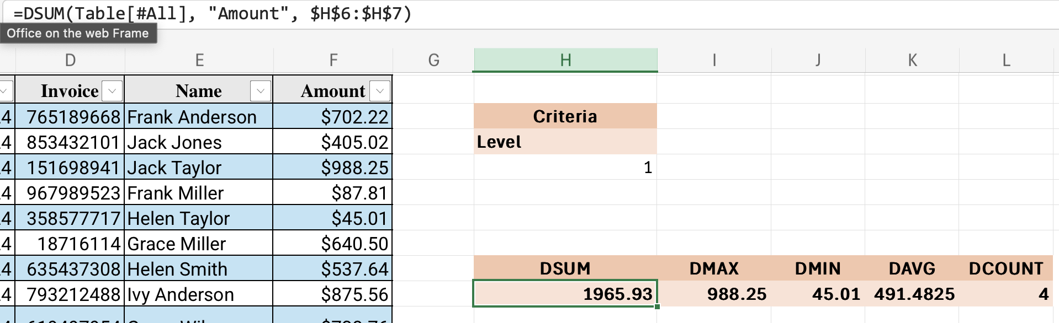
Databse functions
(DSUM, DAVERAGE, DMAX, DMIN, DCOUNT)
Criteria Absolute reference
Single Criteria
All Level 1 invoices Amount

Slide 28
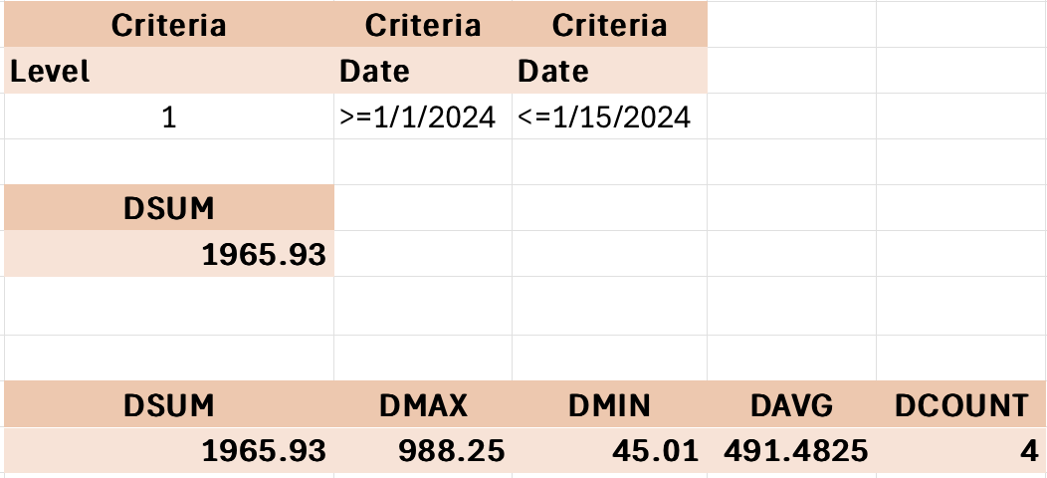
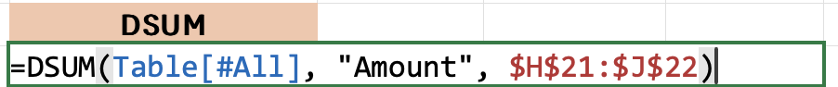
Databse functions
(DSUM, DAVERAGE, DMAX, DMIN, DCOUNT)
Multiple Criteria
All Level 1 invoices Amount

Slide 29
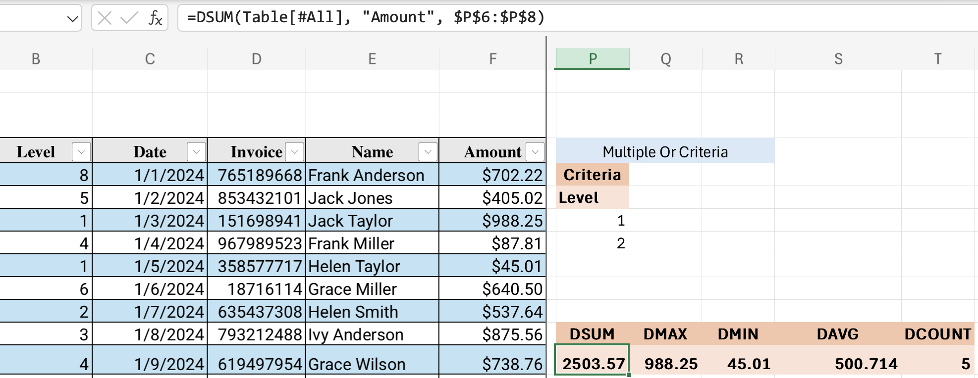
Databse functions
(Logic Criteria )
Multiple OR Criteria
All Level 1 or Level 2 invoices Amount

Slide 30
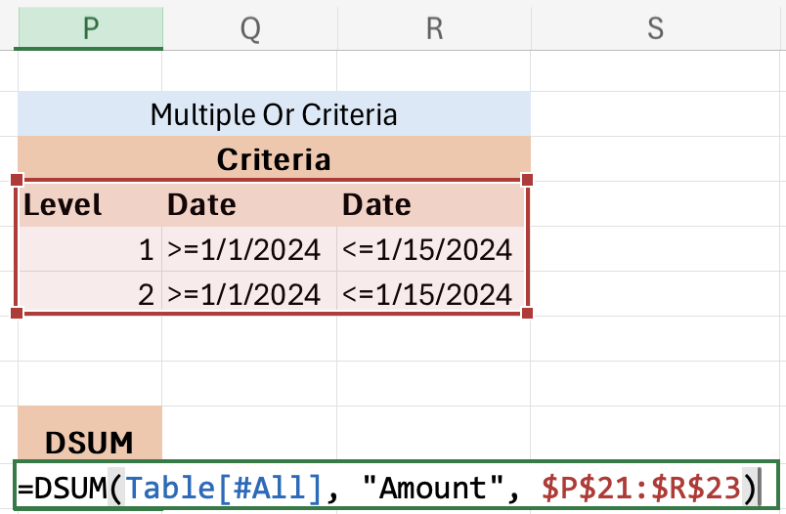
Databse functions
(Logic Criteria )
Multiple AND Criteria

Slide 31
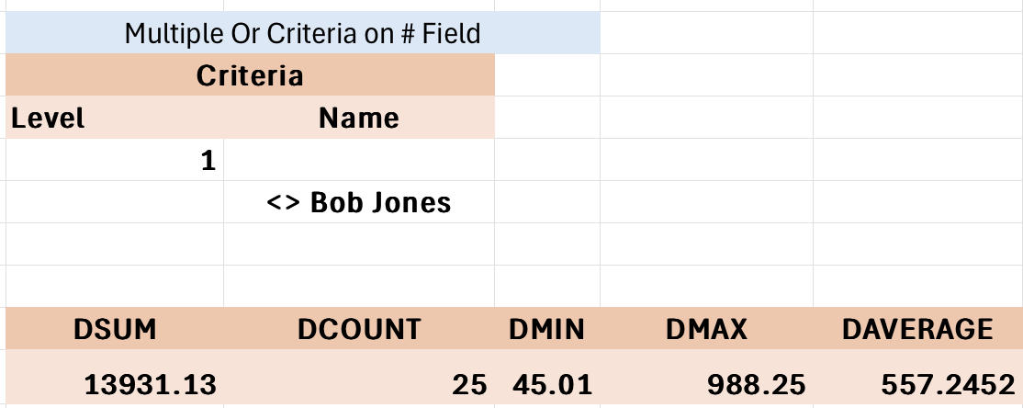
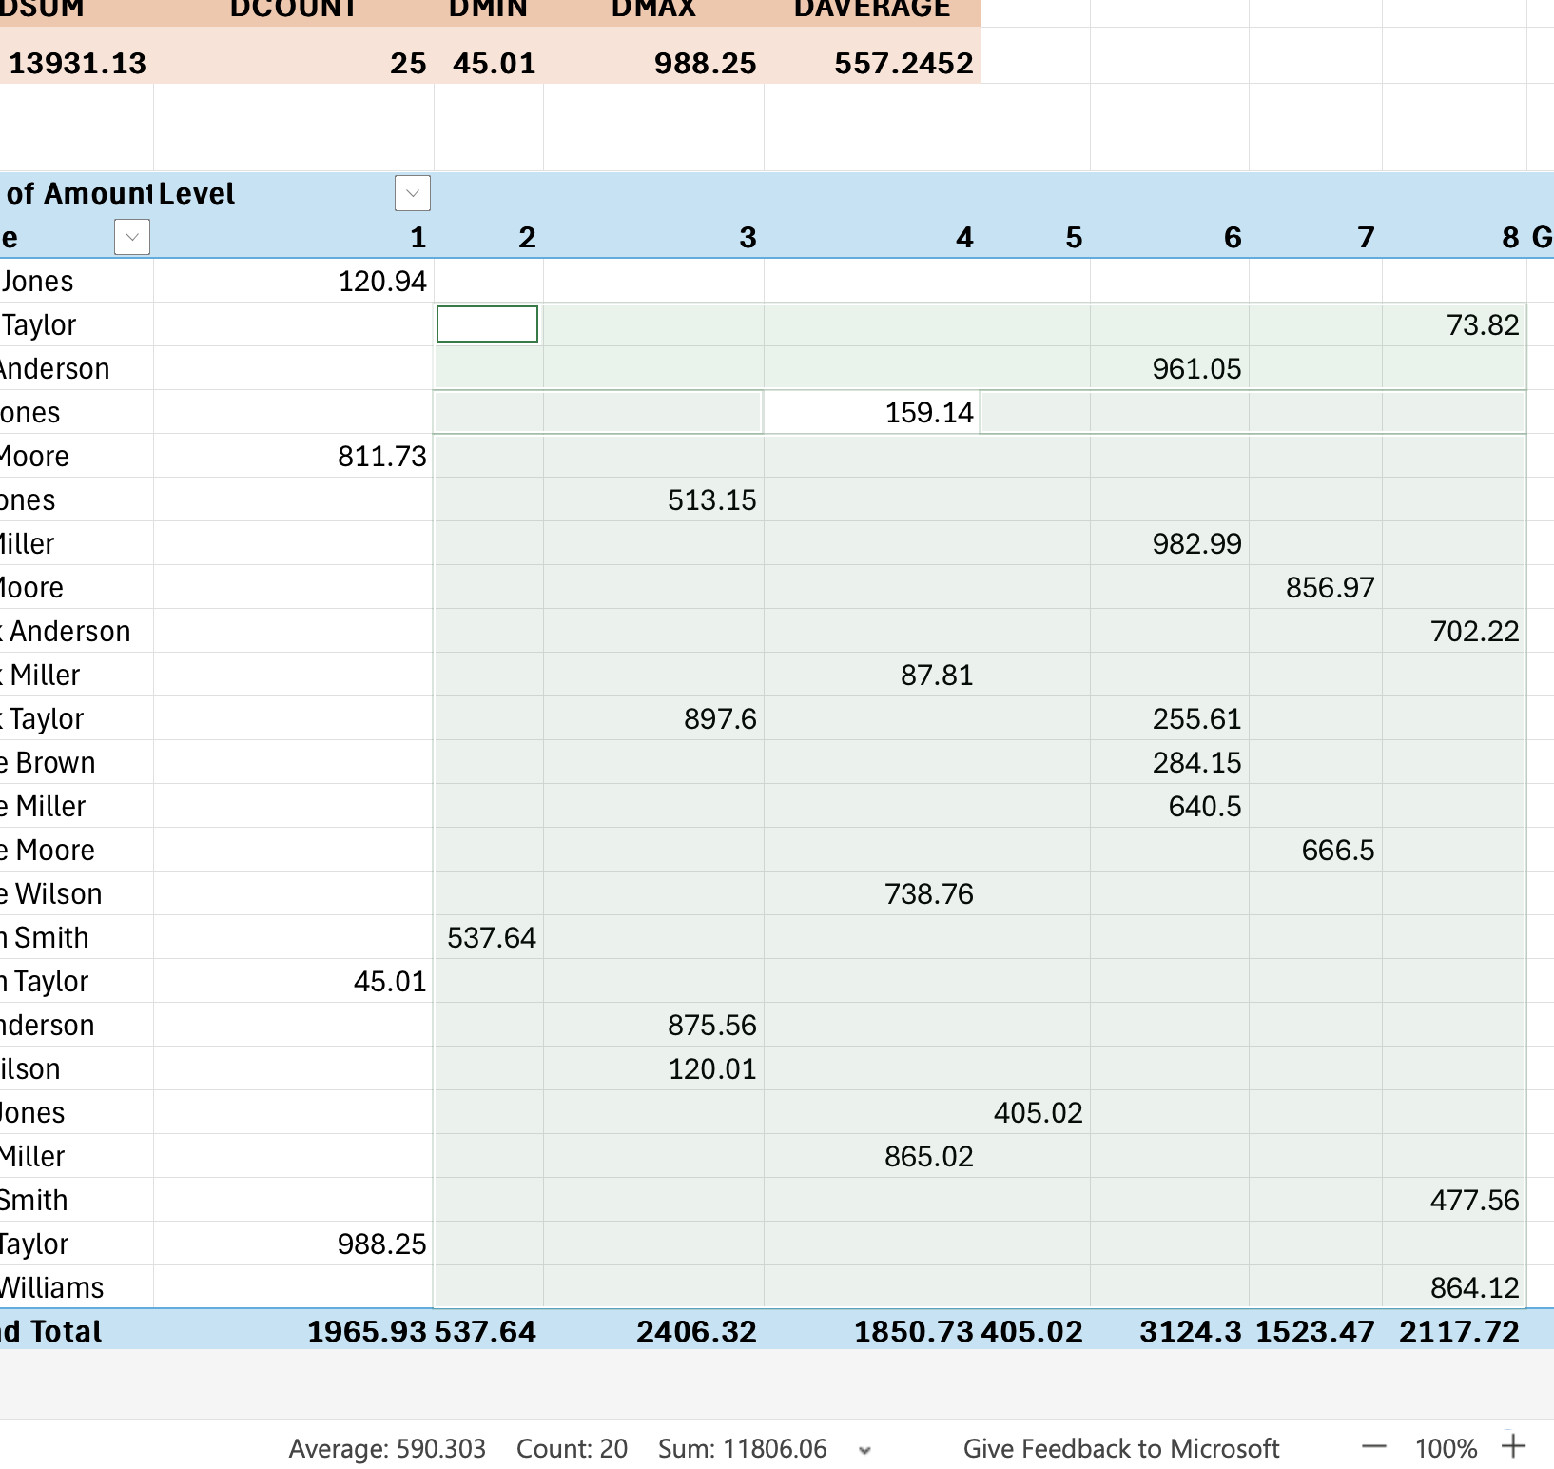
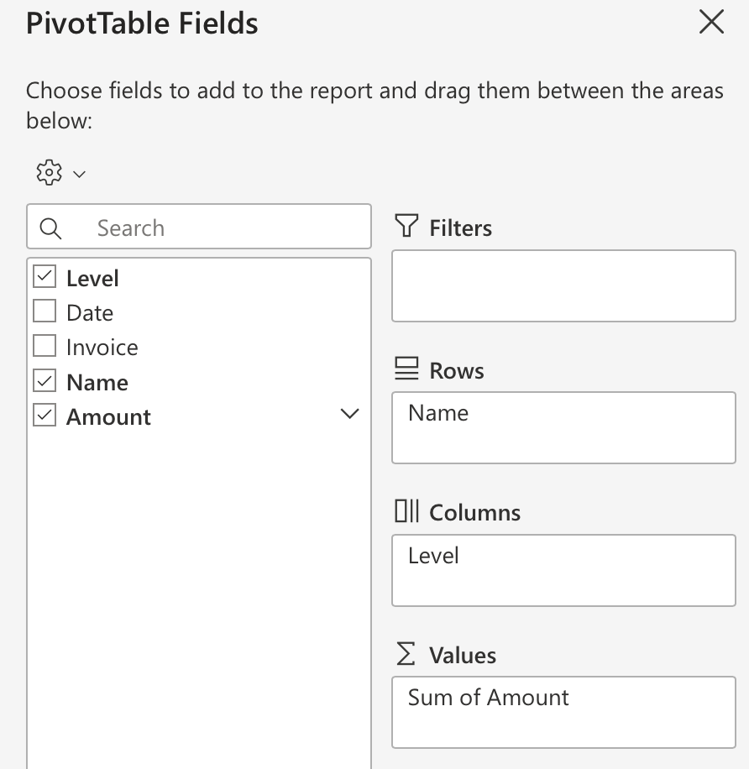
Databse functions
(Logic Criteria )

Slide 32
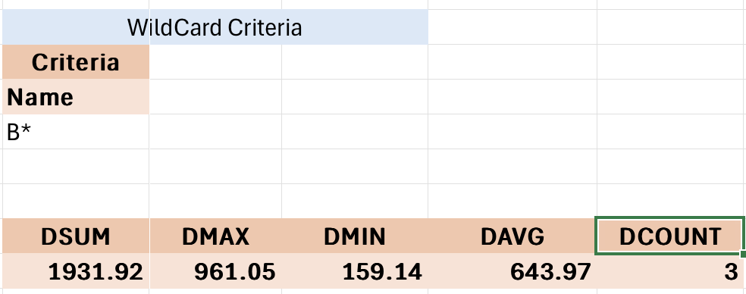
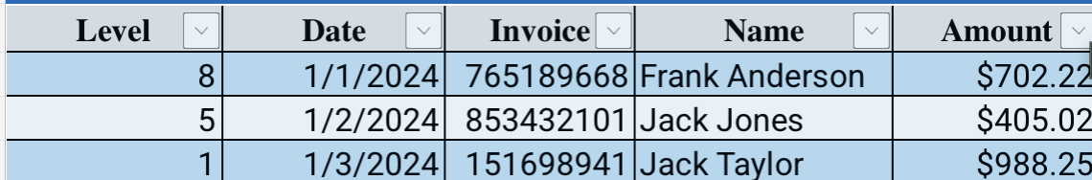
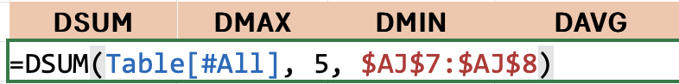
Databse functions
( Wild Card Criteria )
1
2
3
4
5

Slide 33
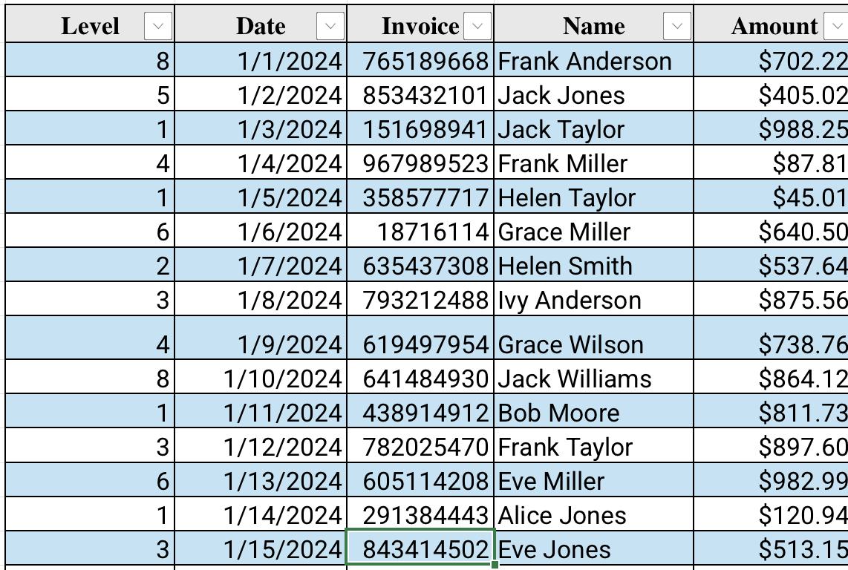
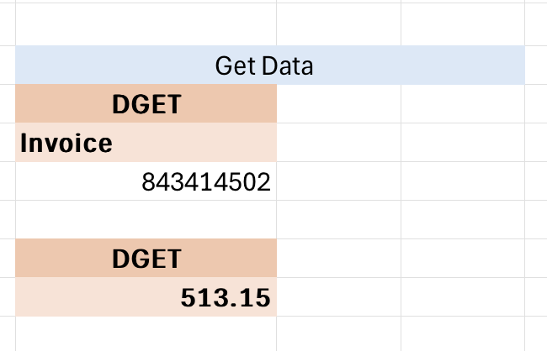
Databse functions
( Wild Card Criteria )

Slide 34
Lab
Use Specialized Functions

Slide 35
Work with Logical Functions

Slide 36
Introduction to logical functions
Decision Making: Logical functions let you build formulas that make decisions based on conditions. Imagine automatically categorizing expenses, applying discounts based on purchase amounts, or flagging deadlines.
Data Analysis: Quickly analyze and filter data based on specific criteria. For example, identify top-performing sales regions, find students who passed an exam, or extract records that meet multiple conditions.
Increased Efficiency: Automate tasks and reduce manual effort. Instead of manually checking and updating cells, logical functions can do the work for you, saving time and improving accuracy.

Slide 37
IF function (syntax, examples, nested IFs)
Decision Making: The IF function allows Excel to make logical decisions based on conditions you define. It's like having your spreadsheet ask "If this is true, then do this; otherwise, do that." This is essential for automating tasks and creating dynamic spreadsheets.
Data Analysis: IF helps you analyze data by categorizing and filtering information. You can use it to identify trends, highlight outliers, and extract meaningful insights from your data.
Flexibility and Control: With nested IFs (IF functions within IF functions), you can create complex logic to handle multiple conditions and outcomes. This gives you powerful control over how your spreadsheet behaves and calculates results

Slide 38
AND, OR functions (combining conditions)
Complex Decision-Making:
Data Filtering
Increased Formula Flexibility:

Slide 39
Practical applications of logical functions (data validation, conditional formatting)
Data Validation: Ensure data accuracy and consistency by setting rules for what can be entered in cells (e.g., only allow numbers between 1 and 10, or specific text values).
Conditional Formatting: Highlight important data points or trends by automatically applying formatting based on cell values (e.g., highlight cells with values above a threshold, or color-code cells based on their content).
Dynamic Analysis: Create flexible and interactive spreadsheets that respond to changing data. Build formulas that adapt to different conditions, making your analysis more powerful and insightful.

Slide 40
Lab
Work with Logical Functions

Slide 41
Work with Date and Time Functions

Slide 42
Date and time formats in Excel
Data Analysis
Data Filtering and Sorting:
Data Visualization

Slide 43
TODAY(), NOW() functions

Slide 44
DAY(), MONTH(), YEAR() functions
Extract Meaningful Information:
Creating summary reports: Analyze sales by month or year.
Tracking deadlines: Identify tasks due in a specific month.
Enable Dynamic Calculations:
Calculate date differences:
Create dynamic filters
Generate date-based sequences

Slide 45
DATEDIF() function (calculating time between dates)
Calculate precise time intervals: DATEDIF allows you to calculate the exact number of days, months, or years between two dates. This is essential for tasks like:
Tracking project durations
Analyzing customer lifecycles
Determining age based on birthdates
Calculating time elapsed since an event
Flexible unit options: DATEDIF provides various unit options ("d", "m", "y", "md", "ym", "yd") to get the precise time difference you need. This flexibility helps you answer questions like:
"How many months are between these two dates, ignoring the year?"
"How many days are between these two dates, ignoring the months and years?"

Slide 46
Practical examples (project timelines, age calculations)
Employee Tenure: Calculate how long an employee has been with the company using their hire date.
Warranty Expiration: Determine if a product is still under warranty by comparing the purchase date to the current date.
Subscription Renewal: Calculate the number of days until a subscription needs to be renewed.
Analyzing Time-Series Data: Use DATEDIF to create groups or bins for time-series data analysis (e.g., group sales data by month or quarter).

Slide 47
Lab
Work with Date and Time Functions

Slide 48
Work with Text Functions

Slide 49
Common text functions (CONCATENATE, LEFT, RIGHT, MID, TRIM)
CONCATENATE / CONCAT: Join text from multiple cells into one
LEFT, RIGHT, MID: Extract characters from a string based on position
TRIM: Remove extra spaces for cleaner data presentation

Slide 50
Combining text from multiple cells
Use CONCATENATE or TEXTJOIN to merge data into a single cell
Combine cell values with custom separators (e.g., commas, spaces)
Practical for creating names, addresses, and formatted text

Slide 51
Extracting specific parts of text strings
Use LEFT, RIGHT, MID functions to capture targeted text portions
Extract specific data like product codes, initials, or IDs
Efficient for standardized data formats (e.g., first 5 characters of a code)

Slide 52
Cleaning up text data (removing spaces, changing case)
TRIM removes leading, trailing, and extra spaces between words
UPPER, LOWER, PROPER adjust text case for consistency
Streamlines data entry and ensures uniform text formatting

Slide 53
Lab
Work with Text Functions

Slide 54
2nd Day
Working with Lists

Slide 55
Working with Lists

Slide 56
Sort Data

Slide 57
Why sort data? (Organization, analysis, finding information)
Organizes data for easier navigation and readability
Simplifies data analysis by grouping related information
Helps quickly find specific data points or trends

Slide 58
Sorting by a single column (ascending, descending)
Sort data in ascending or descending order
Ideal for quick organization based on one key variable
Supports numeric, text, and date-based sorting

Slide 59
Sorting by multiple columns (prioritizing criteria)
Set primary and secondary sorting criteria for detailed order
Helps prioritize important categories within large datasets
Useful for multi-level data organization, like department then name

Slide 60
Custom sort orders (text, dates, custom lists)
Create custom lists to sort data beyond default options
Sort text, dates, or predefined categories (e.g., high/medium/low)
Custom lists save time for frequent, specific sorting needs

Slide 61
Sorting and filtering relationship
Sorting organizes data, while filtering displays specific data
Use sorting to group, then filter to drill down on details
Both functions work together for advanced data analysis

Slide 62
Lab
Sort Data

Slide 63
Filter Data

Slide 64
Introduction to filtering (purpose, benefits)
Purpose: Quickly isolate and view specific data within large datasets
Benefits: Enhances focus on relevant data, improves analysis efficiency
Types of Filters: Basic, advanced, color/icon-based

Slide 65
Applying basic filters (text, number, date filters)
Access filters from the Data tab for easy sorting options
Use text, number, and date filters for specific data types
Filter ranges based on set conditions (e.g., greater than, equals)

Slide 66
Using advanced filter criteria (multiple conditions, wildcards)
Apply multiple conditions for complex filtering needs
Use wildcards (*) to match partial text patterns
Filter data across multiple columns simultaneously

Slide 67
Filtering by color or icon
Filter cells by fill color, text color, or icon set
Useful for highlighting key metrics or conditional formatting
Instantly view categorized data by visual cues

Slide 68
Saving and reapplying filters
Save filter settings for consistent data analysis
Use custom views to quickly switch between filter configurations
Reapply filters after data updates to maintain accuracy

Slide 69
Lab
Filter Data

Slide 70
Query Data with Database Functions

Slide 71
Introduction to database functions (purpose, advantages)
Purpose: Analyze large datasets by querying specific data based on criteria
Advantages: Simplifies data extraction without complex formulas or filters
Common database functions: DSUM, DAVERAGE, DCOUNT, DMAX, DMIN

Slide 72
DSUM, DAVERAGE, DCOUNT functions (syntax, examples)
DSUM: Adds values in a field matching specified criteria
DAVERAGE: Calculates average of values in a field based on criteria
DCOUNT: Counts cells containing numbers in a field matching criteria

Slide 73
Creating database criteria ranges
Criteria ranges define the conditions for database function queries
Place criteria in separate rows/columns for flexible queries
Label criteria columns to match database headers for accurac

Slide 74
Using wildcards and comparison operators in criteria
Wildcards (e.g., “*”) match patterns in text criteria for flexible queries
Use comparison operators (>, <, =) for numeric filtering
Combine criteria with AND/OR for multi-condition queries

Slide 75
Real-world applications of database functions
Financial analysis: Calculate specific expenses or revenues
Inventory management: Count items that meet restocking thresholds
Sales data analysis: Aggregate sales by region, product, or time period

Slide 76
Lab
Query Data with Database Functions

Slide 77
Outline and Subtotal Data

Slide 78
Introduction to outlining (organizing data, creating summaries)
Organize large datasets for easy viewing and navigation
Create summaries to see high-level trends without detailed data
Excel's outline feature simplifies complex data structures

Slide 79
Creating outlines (grouping rows/columns, levels of outlining)
Group rows or columns for structured data views
Use outline levels to switch between detailed and summary views
Set up outlines for efficient data analysis and presentation

Slide 80
Using the Subtotal feature (automatic subtotals, custom functions)
Automatically calculate subtotals for grouped data
Choose from custom functions (Sum, Average, Count, etc.)
Insert subtotals by column or category for clear insights

Slide 81
Collapsing and expanding outline levels
Easily collapse data to hide details and focus on summaries
Expand data levels to drill down into specifics
Adjust outline views for quick data exploration and reporting

Slide 82
Working with grouped data (formatting, analysis)
Format grouped data for better readability and analysis
Apply styles, colors, and borders to highlight summaries
Use grouped data for filtered analysis and customized reporting

Slide 83
Lab
Outline and Subtotal Data

Slide 84
3rd Day
Analyzing Data

Slide 85
Analyzing Data

Slide 86
Create and Modify Tables

Slide 87
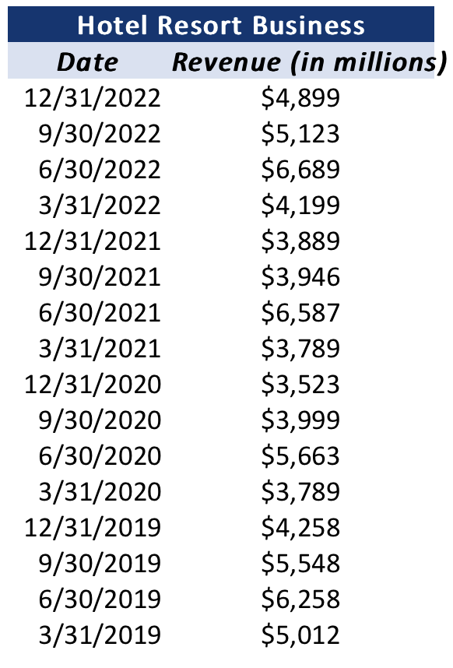
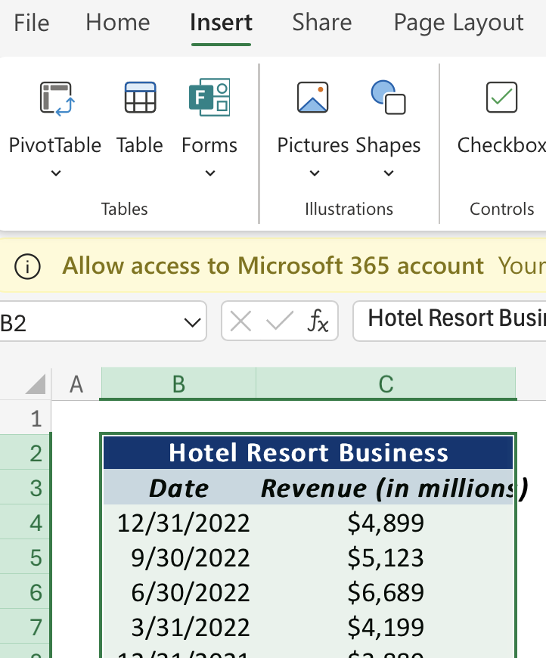
What is an Excel table?
(Benefits of using tables: structured references, built-in filtering/sorting, etc.)
…

Slide 88
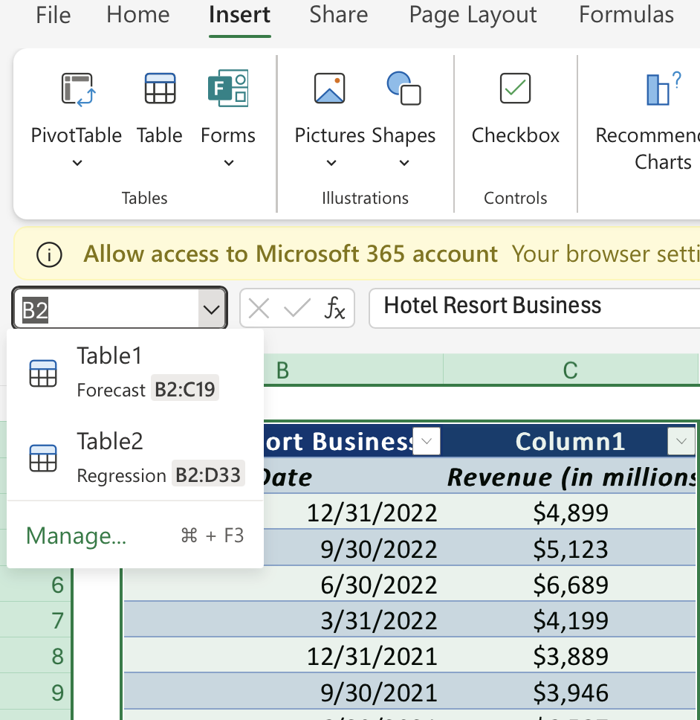
Creating tables
(from existing data, blank table)
A range is a group of selected cells in a worksheet.

Slide 89
Table nomenclature (header row, columns)
A range is a group of selected cells in a worksheet.
It can be single cell, a row, a column, or a block of cells.
Ranges are essential for performing calculations, applying formatting, and working with data in Excel.

Slide 90
Modifying tables (adding/deleting rows/columns, resizing)
A range is a group of selected cells in a worksheet.

Slide 91
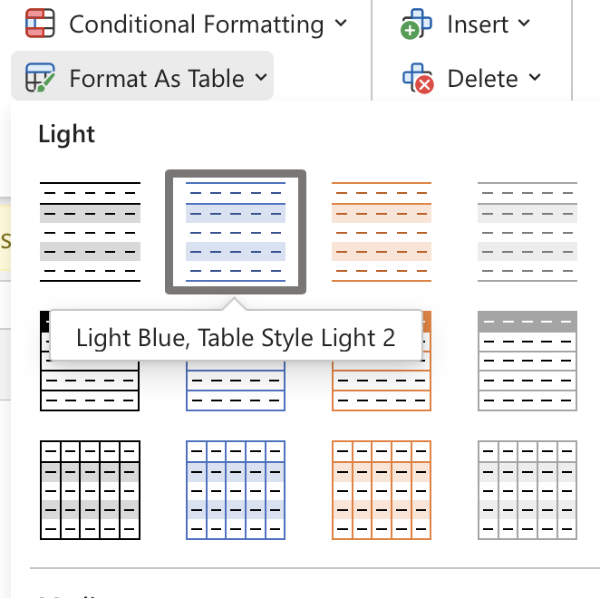
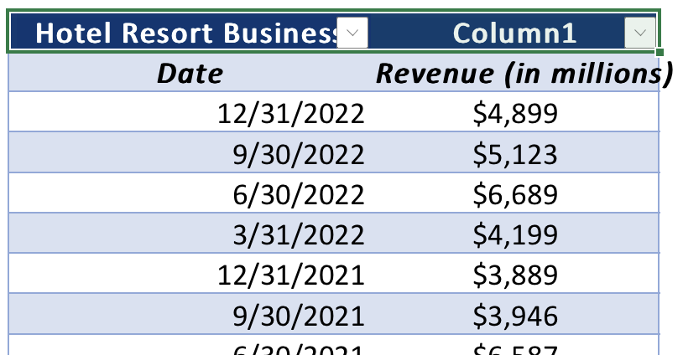
Table styles and formatting
A range is a group of selected cells in a worksheet.

Slide 92
Structured references
(using column names in formulas)
A range is a group of selected cells in a worksheet.

Slide 93
Structured references
(using column names in formulas)
A range is a group of selected cells in a worksheet.

Slide 94
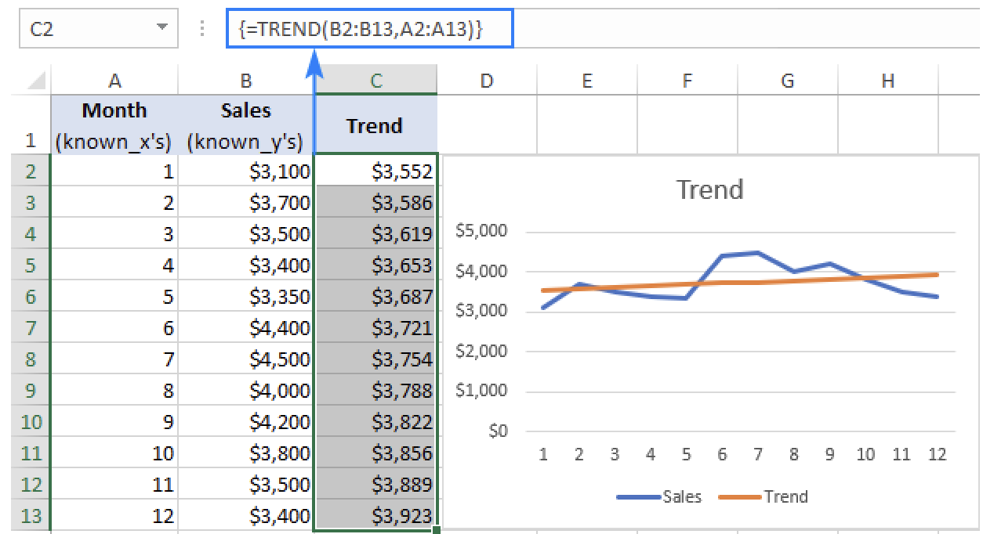
Trend for time series
A range is a group of selected cells in a worksheet.

Slide 95
Projected Trend
A range is a group of selected cells in a worksheet.

Slide 96
Trend formula for multiple sets of x-values

Slide 97
FORECAST vs TREND

Slide 98
Visualize the trend

Slide 99
Trend with moving averag

Slide 100
Lab
Create and Modify Tables

Slide 101
Apply Intermediate Conditional Formatting

Slide 102
Review of basic conditional formatting
Refresh on applying basic conditional formatting rules
Emphasize formatting based on cell values and text
Quick tips for accessing conditional formatting options

Slide 103
Highlight Cells Rules (greater than, less than, between, equal to, text that contains)
Refresh on applying basic conditional formatting rules
Emphasize formatting based on cell values and text
Quick tips for accessing conditional formatting options

Slide 104
Top/Bottom Rules (top 10 items, bottom 10%, above average)
Use "greater than" or "less than" rules for quick insights
Apply "between" or "equal to" to define specific ranges
Highlight cells based on text criteria (e.g., “text that contains”)

Slide 105
Data Bars (visual representation of values within cells)
Highlight top/bottom 10 items to identify extremes in data
Use top/bottom percentage rules (e.g., bottom 10%) for depth
Identify values above or below average quickly

Slide 106
Color Scales (gradient colors based on value ranges)
Visualize values within cells with gradient-filled data bars
Compare data magnitude across cells at a glance
Adjust data bar color and style for enhanced readability

Slide 107
Icon Sets (applying icons based on conditions)
Apply gradient color scales to show value ranges
Use color scales to identify high, low, and mid values
Choose from multiple color scales for varied data insights

Slide 108
Lab
Apply Intermediate Conditional Formatting

Slide 109
Apply Advanced Conditional Formatting

Slide 110
Introduction to Advanced Conditional Formatting
Review the basics: Conditional formatting allows you to apply formatting to cells based on rules and criteria.
Advanced techniques involve using formulas, managing multiple rules, and understanding rule precedence.
This allows for more dynamic and complex formatting effects to highlight specific data patterns and insights.
basic conditional formatting (e.g., highlighting cells above a certain value) transitioning to a more complex example
(e.g., highlighting duplicates with different colors).

Slide 111
Conditional Formatting with Formulas
Instead of predefined rules, you can use formulas to define the criteria for conditional formatting.
This provides greater flexibility and control over the formatting.
Formulas must evaluate to TRUE or FALSE.
Example: =A1>AVERAGE(A:A) to highlight values above the average.
step-by-step example of creating a conditional formatting rule using a formula.

Slide 112
Understanding Rule Precedence
You can apply multiple conditional formatting rules to the same range.
Excel follows a specific order of precedence when applying rules.
Rules are evaluated from top to bottom in the Conditional Formatting Rules Manager.
"Stop If True" option can be used to prevent subsequent rules from being evaluated.
Conditional Formatting Rules Manager and illustrate how rule order affects the outcome.

Slide 113
Advanced Conditional Formatting Techniques
Unlock Data Insights: Go beyond basic highlighting. Use formulas and multiple rules to reveal complex patterns, outliers, and trends hidden within your data.
Boost Decision-Making: Transform raw data into actionable intelligence. Visually identify top performers, areas needing attention, and potential risks with dynamic formatting.
Enhance Communication: Create compelling reports and dashboards. Communicate your findings clearly and effectively with impactful visuals that emphasize key information.

Slide 114
Lab
Apply Advanced Conditional Formatting

Slide 115
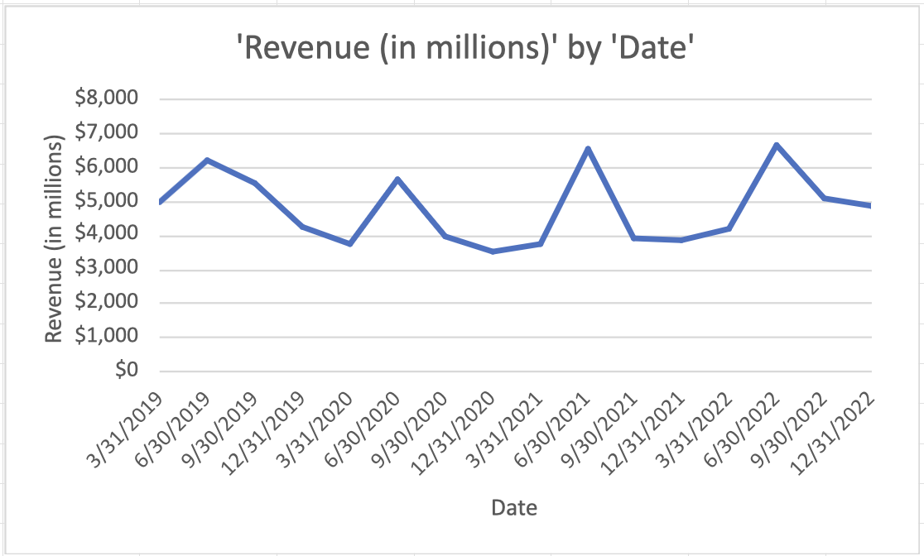
Data Analysis

Slide 116
Introduction to Data Analysis in Excel
Overview of data analysis tools in Excel
Importance of data-driven decision-making
Excel’s role in modern data analysis processes

Slide 117
Organizing Data with Tables
Use Excel Tables for structured data management
Benefits of Tables: Auto-expansion, filtering, sorting
Apply Table styles for visual clarity and consistency

Slide 118
Descriptive Statistics with Data Analysis ToolPak
Install and access the Analysis ToolPak in Excel
Perform basic statistical analysis (mean, median, mode)
Use Data Analysis ToolPak for variance, standard deviation

Slide 119
Analyzing Trends with Charts and Graphs
Create charts to visualize data trends effectively
Use line, bar, and pie charts for different insights
Customize charts for clarity and professional appeal

Slide 120
Using PivotTables for In-Depth Analysis
Quickly summarize and analyze large datasets
Drag-and-drop fields for custom reporting
Filter data using Slicers for targeted analysis

Slide 121
Forecasting with Excel
Use Excel’s Forecast Sheet to predict trends
Apply moving averages for time-series forecasting
Benefits of forecasting for planning and decision-making

Slide 122
Advanced Data Analysis with Power Query
Clean, transform, and combine data sources with Power Query
Automate data processing with repeatable steps
Benefits of Power Query for data preparation and analysis

Slide 123
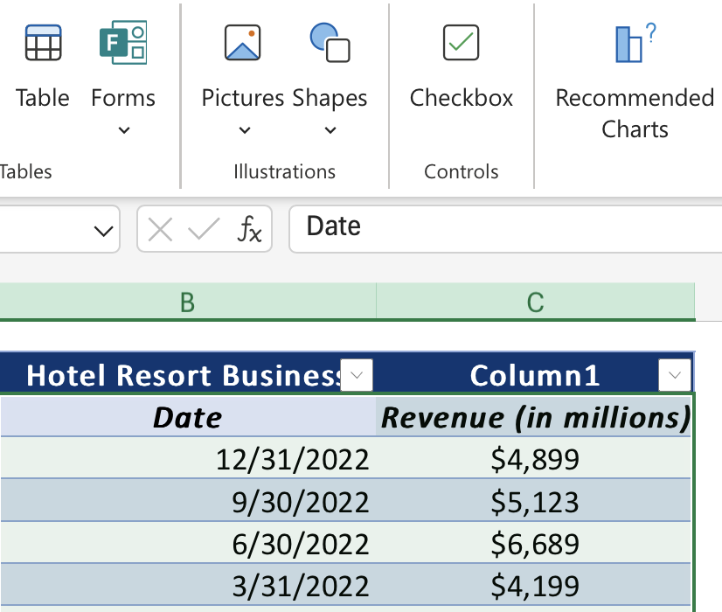
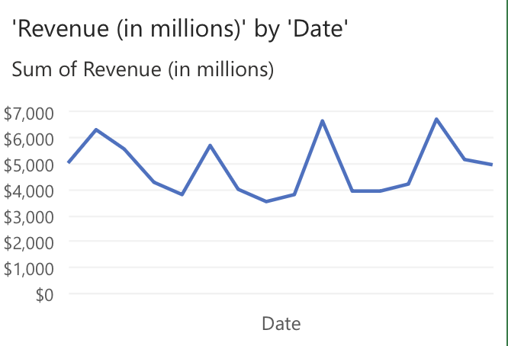
Recommended Chart
Review the basics: Conditional formatting allows you to apply formatting to cells based on rules and criteria.
basic conditional formatting (e.g., highlighting cells above a certain value) transitioning to a more complex example
(e.g., highlighting duplicates with different colors).

Slide 124
Seasonality
Review the basics: Conditional formatting allows you to apply formatting to cells based on rules and criteria.
Seasonality
basic conditional formatting (e.g., highlighting cells above a certain value) transitioning to a more complex example
(e.g., highlighting duplicates with different colors).

Slide 125
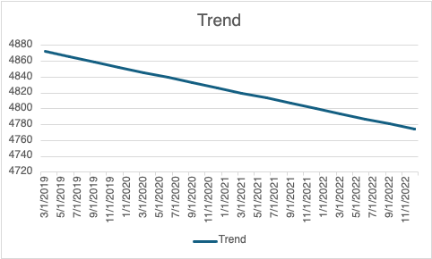
Data Forecast
Review the basics: Conditional formatting allows you to apply formatting to cells based on rules and criteria.
Seasonality
basic conditional formatting (e.g., highlighting cells above a certain value) transitioning to a more complex example
(e.g., highlighting duplicates with different colors).

Slide 126
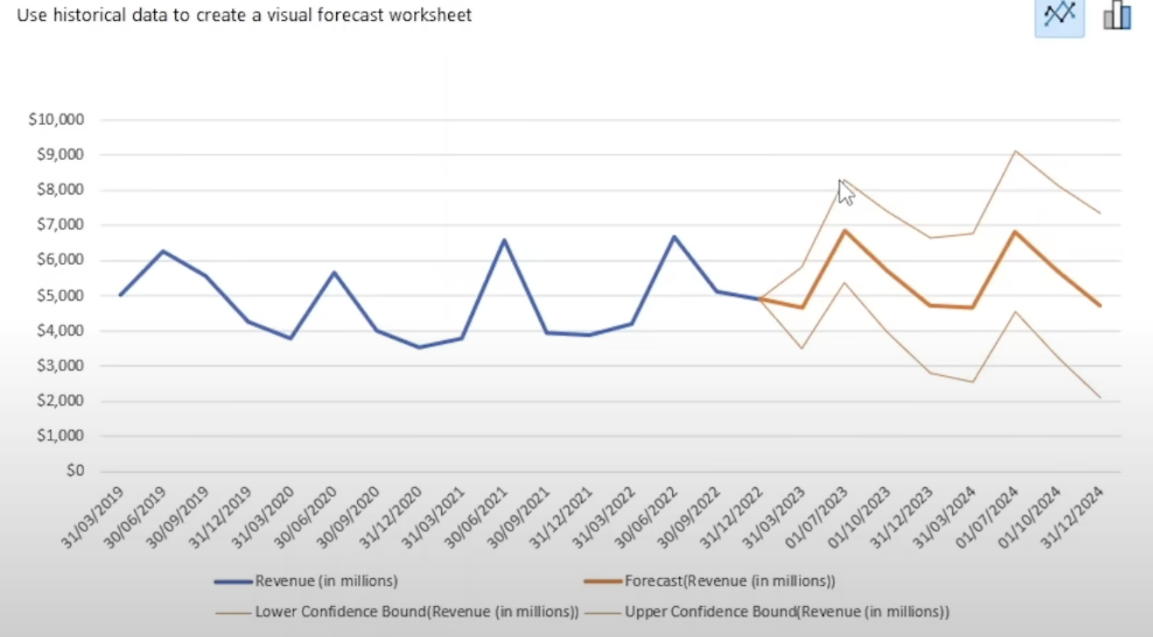
Data Forecast
Review the basics: Conditional formatting allows you to apply formatting to cells based on rules and criteria.
basic conditional formatting (e.g., highlighting cells above a certain value) transitioning to a more complex example
(e.g., highlighting duplicates with different colors).

Slide 127
Lab
Apply Advanced Conditional Formatting

Slide 128
4th Day
Visualizing Data with Charts

Slide 129
Visualizing Data with Charts

Slide 130
Create Charts

Slide 131
Why use charts? (Visualizing data for better understanding and communication)
It can be single cell, a row, a column, or a block of cells.

Slide 132
Types of charts?
(column, bar, line, pie, scatter, etc.) - with examples and when to use each)
It can be single cell, a row, a column, or a block of cells.

Slide 133
Choosing the right chart type for your data
Understand your data and your message
What story do you want to tell with your data?
What type of data do you have (categorical, numerical, time-series, etc.)?
What relationships or trends do you want to highlight?
Common Chart Types and Their Uses:
Bar/Column Charts: Comparing categories, showing changes over time.
Line Charts: Tracking trends and changes over time.
Pie Charts: Showing parts of a whole (percentages or proportions).
Scatter Plots: Exploring correlations between two variables.
Area Charts: Showing changes in totals over time and highlighting the magnitude of values.

Slide 134
Choosing the right chart type for your data
Matching Chart Type to Data:
Categorical Data: Bar/column charts, pie charts.
Numerical Data: Line charts, scatter plots, histograms.
Time-Series Data: Line charts, area charts.
Consider your audience:
Choose charts that are easy to understand and interpret.
Avoid cluttering charts with too much information.
Examples: Show a few examples of different chart types used effectively to illustrate different types of data and insights.

Slide 135
Creating a chart
(selecting data, inserting a chart, basic chart elements)
Select your data: Highlight the cells containing the data you want to visualize, including headers if you have them.
Go to the "Insert" tab: In the Excel ribbon, click on the "Insert" tab.
Choose a chart type: In the "Charts" group, you'll see a variety of chart types (bar, line, pie, etc.). Click the type that best suits your data and the message you want to convey.
Customize your chart: Once the chart is created, you can customize it using the "Chart Design" and "Format" tabs in the ribbon. Here you can change the chart title, axis labels, colors, legends, and more.

Slide 136
Chart elements
(title, axis labels, legend, data series)
Chart Title: Clearly and concisely describes the main point or message of the chart
Axis Labels: Provide context and units of measurement for the data on each axis (horizontal and vertical).
Legend: Explains the meaning of different colors, symbols, or patterns used to represent data series.
Data Series: The actual data points plotted on the chart, represented by bars, lines, slices, etc.

Slide 137
Lab
Create Charts

Slide 138
Modify and Format Charts

Slide 139
Modifying chart elements (editing titles, axis labels, legends)
Chart Title: Click on the existing title to edit it directly, or right-click the chart and select "Edit Chart Title" to change the content, font, size, and color.
Axis Labels: Double-click an axis label to edit it. Use the "Format Axis" options to change the label's text, font, number format, alignment, and more.
Legend: Click on the legend to select it. Use the "Format Legend" options to change its position, layout, font, and appearance. You can also add or remove legend entries.
Data Labels: Add data labels to your chart to display the exact values of data points. Right-click a data series, select "Add Data Labels," and then customize their format, position, and content.

Slide 140
Changing chart type (switching between different chart types)
To better highlight different aspects of your data
To improve clarity and understanding:
To keep your audience engaged:

Slide 141
Chart layouts (predefined layouts for different chart elements)
It can be single cell, a row, a column, or a block of cells.

Slide 142
Formatting chart elements (colors, fonts, styles, data labels)

Slide 143
Adding trendlines and error bars
Visualize Trends: Trendlines help you see the overall direction and pattern of your data, making it easier to identify increases, decreases, or other trends. This is especially useful for forecasting or making predictions.
Show Data Variability: Error bars visually represent the variability or uncertainty in your data points. They can show standard deviation, standard error, or confidence intervals, giving your audience a better understanding of the data's reliability.

Slide 144
Lab
Modify and Format Charts

Slide 145
Use Advanced Chart Features

Slide 146
Combination charts
(combining different chart types in one chart)
Clarity and Focus: Different layouts emphasize different chart elements (legend, titles, data labels). Choose a layout that best highlights the key insights you want your audience to grasp.
Visual Appeal: Layouts can dramatically improve the look and feel of your chart. Experiment to find a layout that is both visually appealing and effective in communicating your data.
Efficiency: Predefined layouts save you time and effort. Instead of manually adjusting each element, you can quickly apply a layout that meets your needs.

Slide 147
Sparklines
(miniature charts within cells)
Instant Data Visualization:
Space Savers:
Enhanced Data Analysis:

Slide 148
Chart templates
(saving and reusing custom chart formats)

Slide 149
Linking charts to external data sources
Real-time Updates
Data Integrity:
Efficiency and Scalability:

Slide 150
Creating interactive charts with slicers and filters
Link Charts to External Data Sources: Demonstrate how to connect charts to dynamic data sources (e.g., SharePoint lists or external Excel files), ensuring that updates to the source automatically reflect in the charts.
Interactive Charts with Slicers: Explain how to use slicers with pivot charts to filter data visually, enabling users to focus on specific segments without altering the data structure.
Dynamic Filtering with Filters: Showcase the use of chart filters for instant, customizable views, allowing users to select specific data points or categories to explore trends and insights interactively.

Slide 151
Lab
Use Advanced Chart Features

Slide 152
5th Day
Using PivotTables and Pivot
Charts

Slide 153
Using PivotTables and PivotCharts

Slide 154
Create a PivotTable

Slide 155
What is a PivotTable?
(Definition, benefits, applications)
A PivotTable is a dynamic tool for summarizing, analyzing, and exploring large data sets by grouping and rearranging data.
Benefits: Simplifies data analysis, highlights trends, and enables quick reporting without modifying source data.
Applications: Useful for generating sales reports, performance summaries, and identifying patterns in extensive data sets.

Slide 156
Creating a PivotTable
(from a range or table, using the Recommended PivotTables feature)
Steps to create from a range or table: Select your data > Insert > PivotTable.
Recommended PivotTables: Excel suggests PivotTable layouts based on the data to streamline the creation process.
Choose location for the PivotTable (New Worksheet/Existing Worksheet).

Slide 157
PivotTable structure
(Rows, Columns, Values, Filters areas)
Rows: Categorizes data vertically.
Columns: Adds headers across the top.
Values: Provides the core data for analysis, often summarized with sums or averages.
Filters: Allows segmenting data for focused views.

Slide 158
Adding fields to the PivotTable
(dragging and dropping)
Drag fields into Rows, Columns, Values, or Filters areas.
Adjust placements to reshape data views.
Drop fields as needed for customized reports.

Slide 159
Changing the summarization function
(Sum, Count, Average, etc.)
Right-click values, choose Summarize Values By.
Options: Sum, Count, Average, Max, Min, etc.
Helps in exploring different data perspectives.

Slide 160
Lab
Create a PivotTable

Slide 161
Analyze PivotTable Data

Slide 162
Sorting data in a PivotTable
(ascending/descending order)
Reorder data in your PivotTable by sorting any field (e.g., sales by region).
Focus on specific data subsets by filtering with report filters, slicers, or timelines.
Combine sorting and filtering to quickly find and analyze the information you need.

Slide 163
Filtering data
(using report filters, slicers, timelines)
Report Filters:
Filter data at the highest level of your PivotTable.
Use drop-down menus to select the items you want to include or exclude.
Great for focusing on specific segments of your data (e.g., a particular region or year).
Slicers:
Visual, interactive filters that make it easy to select and deselect categories.
Use buttons to control which data is displayed in the PivotTable.
Ideal for filtering categorical data (e.g., product names, customer segments).
Timelines:
Filter data by date ranges using a visual timeline.
Quickly select specific time periods (years, quarters, months) to analyze.
Perfect for exploring trends and patterns over time.

Slide 164
Grouping data
(creating groups for dates, numbers, etc.)
Create meaningful groups within your data (e.g., group dates into months or quarters).
"Drill down" to see the individual records that make up a summarized value.
Explore your data at different levels of detail to gain deeper insights.

Slide 165
Drilling down into data
(exploring the underlying details)
Create meaningful groups within your data (e.g., group dates into months or quarters).
"Drill down" to see the individual records that make up a summarized value.
Explore your data at different levels of detail to gain deeper insights.

Slide 166
Calculated fields
(creating custom calculations within the PivotTable)
Add custom calculations to your PivotTable (e.g., calculate profit margins or sales growth).
Derive new metrics and perform calculations on summarized data.
Tailor your analysis with calculated fields specific to your reporting needs.

Slide 167
Lab
Analyze PivotTable Data

Slide 168
Present Data with PivotCharts

Slide 169
What is a PivotChart?)
( Relationship with PivotTables, benefits
Visualize PivotTable Insights: PivotCharts bring your PivotTable data to life with interactive charts.
Dynamic Data Exploration: Easily explore trends, comparisons, and patterns with flexible chart options.
Enhanced Presentations: Create compelling visuals to communicate your data effectively.

Slide 170
Creating a PivotChart
( from an existing PivotTable, choosing chart types)
Seamless Creation: Instantly generate a PivotChart from an existing PivotTable.
Diverse Chart Types: Choose from a variety of chart types (column, line, pie, etc.) to suit your data.
Customization: Tailor your PivotChart with titles, legends, and data labels for clarity.

Slide 171
Modifying PivotChart elements
(chart titles, legends, data labels)
Visual Enhancements: Apply colors, styles, and layouts to make your charts visually appealing.
Fine-grained Control: Customize chart elements (axes, legends, data labels) for precise presentation.
Professional Polish: Create charts that are both informative and visually engaging

Slide 172
Formatting PivotCharts
(colors, styles, layouts)
Dynamic Filtering: Use slicers and timelines to interactively filter your PivotChart data.
Data Exploration: Explore different data perspectives and drill down into details.
Engaging Presentations: Create dynamic presentations that allow for audience interaction.

Slide 173
Interactive features
(filtering data with slicers and timelines)
It can be single cell, a row, a column, or a block of cells.

Slide 174
Lab
Present Data with PivotCharts

Slide 175
Filter Data by Using Timelines and Slicers

Slide 176
Timelines
(filtering data by date ranges)
Quickly filter dates in a PivotTable with a visual, interactive timeline.
Easily select date ranges (years, quarters, months) to analyze specific periods.
Ideal for exploring trends and patterns over time.

Slide 177
Slicers
(visual filters for categorical data)
Quickly filter dates in a PivotTable with a visual, interactive timeline.
Easily select date ranges (years, quarters, months) to analyze specific periods.
Ideal for exploring trends and patterns over time.

Slide 178
Connecting slicers to multiple PivotTables
Synchronized Filtering: Connect a single slicer to multiple PivotTables to filter them all at once.
Coordinated Analysis: Explore relationships and patterns across different datasets with synchronized filtering.
Enhanced Insights: Gain a more comprehensive view of your data by seeing how changes in one PivotTable affect others.

Slide 179
Creating interactive dashboards with slicers and timelines
Combine slicers and timelines to create dynamic dashboards.
Connect slicers to multiple PivotTables to filter them simultaneously.
Build interactive reports where users can explore data by different dimensions.

Slide 180
Lab
Filter Data by Using Timelines and Slicers

Slide 181
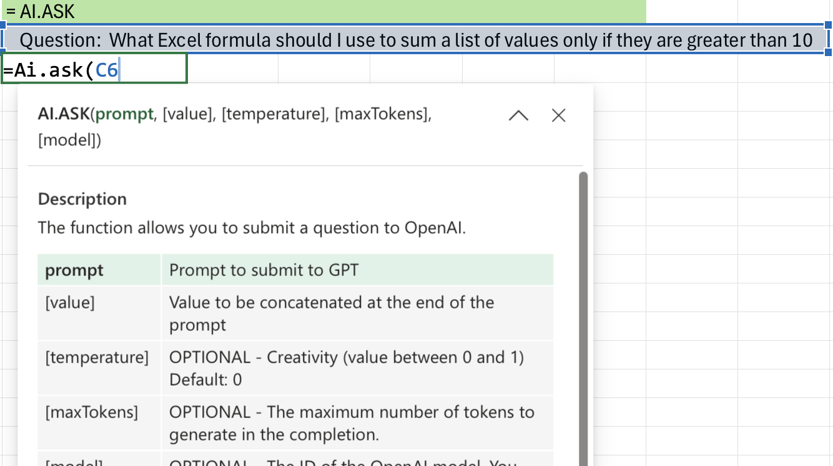
AI.ASK

Slide 182
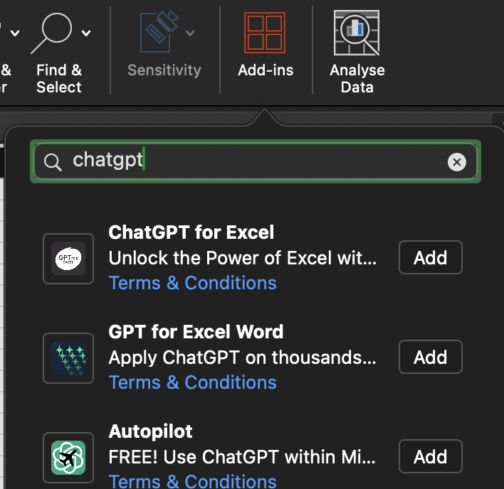
Addins
ChatGPT For Excel
It can be single cell, a row, a column, or a block of cells.

Slide 183
Addins
ChatGPT For Excel
It can be single cell, a row, a column, or a block of cells.

Slide 184
Lab
Filter Data by Using Timelines and Slicers

